Slide 1

Python I
Arjan van der Velde
arjan.vandervelde@umassmed.edu
https://sites.google.com/site/gsbsbootstrappers/courses-workshops/python
http://bioinfo.umassmed.edu/bootstrappers/bootstrappers-courses/python1/index.html
Sessions:
Tuesday, December 2nd, 5pm-7pm
Thursday, December 4th, 5pm-7pm
Tuesday, December 9th, 5pm-7pm
Thursday, December 11th, 5pm-7pm
Amp III S6-102
Notes:
Alfred Simkin

Slide 2
Day 1

Slide 3
Basic Bioinformatics
Different gene names
Other pathways
DNase footprints
RNA-Seq results
miRNA IDs
Anything else
Gene names
Pathways
Genomic regions
Transcripts
Anything else
More intersections..

Slide 4
Examples
Find pathways overlapping with upregulated genes
Find promoters overlapping with ChIP-Seq reads
Find upregulated genes that are novel (that don’t overlap) relative to some other treatment
Find primers that don’t overlap with high GC-content regions of the genome

Slide 5
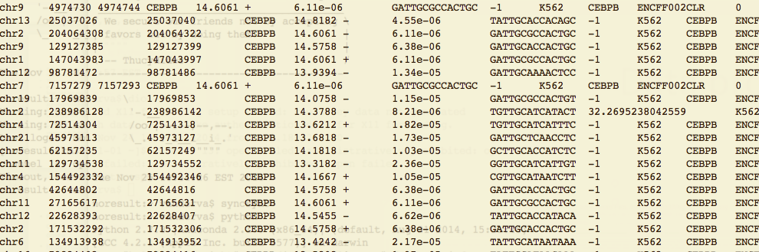
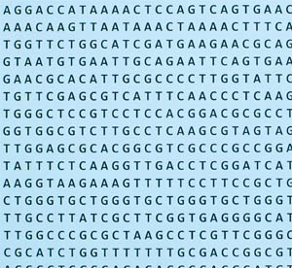
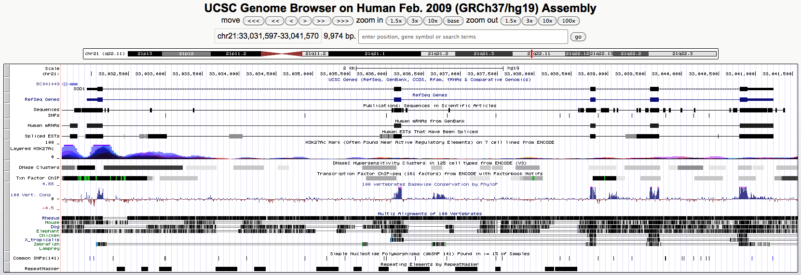
Basic Bioinformatics
+
+
=

Slide 6
Objectives
Learn the logical structure of programming languages
Open, analyze and close large data files
By the end, write simple programs to calculate statistics, compare large data files to each other and extract relevant data
Know how to apply programming to simple large scale tasks

Slide 7
Python is a great place to start
The command are like natural English
Many modules exist that enable common tasks, such as statistics, graphing, etc.
Python is an open language and a large community exists that supports and continuously improves the language
Python is a good language for text processing and therefore for many Bioinformatics tasks

Slide 8
Course Layout
Session I
Session II
Intro
What is programming?
Introduction iPython Notebooks
Variables and data types, simple conversions
Expressions and conditionals
Lists
Simple iteration
Splitting and sorting

Slide 9
Course Layout
Session III
Session IV
Scripting
Reading and writing files
How are (text) files represented?
Delimiters, column based text data
Data transformations
Dictionaries
Functions
Sample problems
Using existing code (modules)
Loading modules
Read a genome?
How about sequence data?

Slide 10
Course Layout
Session V

Slide 11
Learning by doing
Programming is very practical
It’s a craft
Short explanations (5-10 min) followed by a set of instructive exercises (10-30 min)
3-5 blocks each session

Slide 12
What is Python?
Python is a programming language that came about in the 90s and has become very popular over the past ten years
There is a solid community and there are many online resources
Currently the are two main branches of Python, version 2 and version 3. Python 3 is not fully backward compatible and 2.7 is still the most widely used version
Python is an interpreted language; programs written in the Python language are run by the Python interpreter (called python)
Python commands can be typed directly into the interpreter but are usually saved in a file (a script) that is then read and executed by python.
In the first two sessions we will be using iPython Notebook to interact with python

Slide 13
Getting help
Python comes with a built-in help system, called pydoc, as well full documentation online.
https://docs.python.org/2.7/reference/
https://docs.python.org/2.7/library/

Slide 14
Troubleshooting errors
In programming, most things don’t work the first time
By breaking a complex statement into parts, you can often see where the programming language didn’t understand you
Example: 2 / (4 + 6) * 4 should give 0.8 but it doesn’t
4 + 6
2 / 10
0.2 * 4

Slide 15
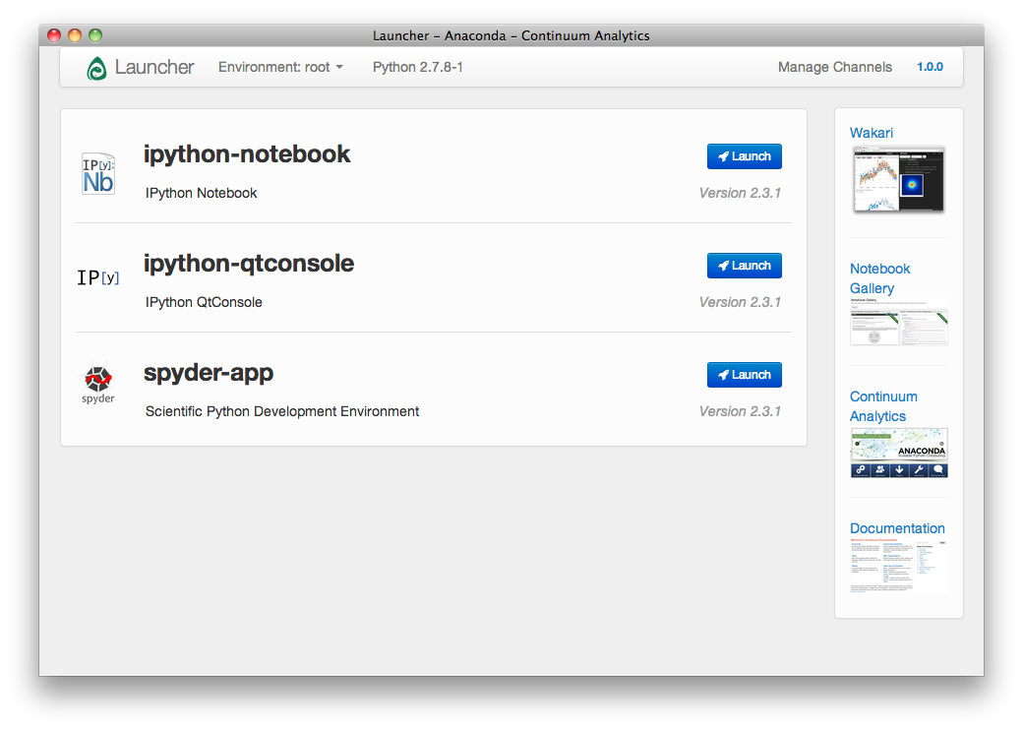

Let’s start

Slide 16
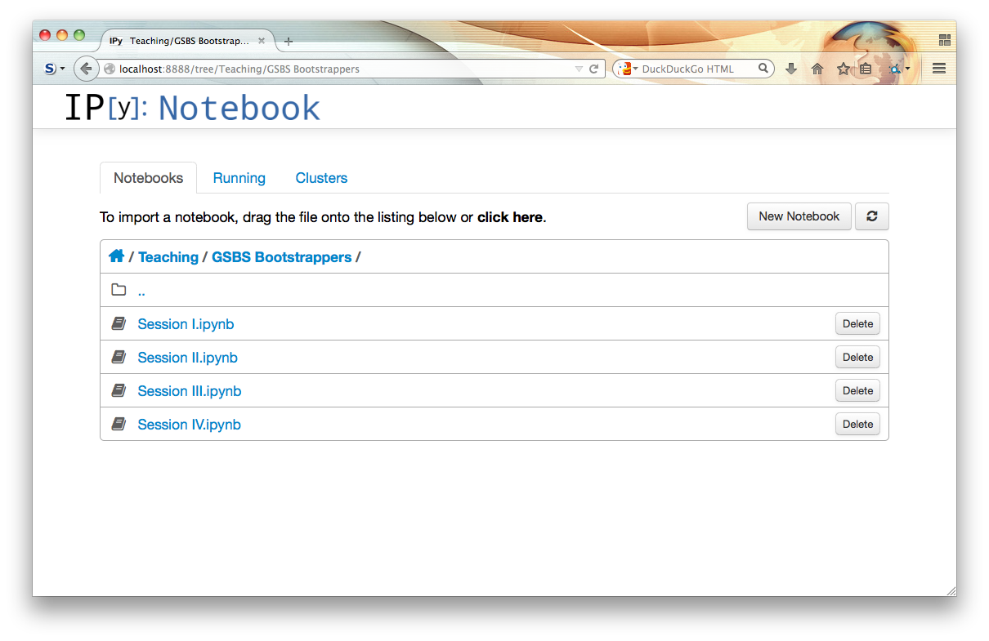
iPython Notebook

Slide 17
Exercises 1
The goal of these exercises is to get familiar with the Python interpreter and with iPython notebook

Slide 18
Exercises 1 Explanation
Characters with quotes around them are strings
Adding two strings together concatenates them
Numbers without quotes are integers
Adding two integers together returns the sum of the two integers
Adding an integer and a string together is not allowed because python doesn't know which type of addition is meant.
Strings and integers each have certain operations that can be done on them whose results can be built into more complex expressions
Trying to do math operations on a string or string operations on numbers is an extremely common bug in bioinformatics programs.

Slide 19
Information storage
All information entered into python has a data type or 'type'
Simplest data types: str, int, and float (strings, integers, and decimals)
Examples:
'hello' (string, known to python as str)
52 (integer, known to python as int)
35.4 (decimal, known to python as float)
Python automatically guesses each information type and has certain operations it can do on it.
Information is stored in variables using an “=” sign. From then on, when you type the variable, python retrieves the value.

Slide 20
Things you can do with int, str, and float
Integers:
Add, subtract, multiply, divide, take exponents, compute remainders, sort numbers by size, anything mathematical, results will always be integers (explains division problem from Exercises 1)
Floats:
Same as integers, but results will be decimals (python recognizes the decimal point)
Strings:
In programming, a string is a series of letters. A sentence in English would be an example (python recognizes the quotes).
Strings can concatenate two strings into a bigger one (like DNA), grab parts of strings, insert extra letters on the end of strings, change parts of a string into something else (like translating cDNA), sort things alphabetically, reverse strings, and much more
Try Exercises 2

Slide 21
Exercises 2 conclusions
Data types can sometimes be converted between each other, allowing formerly impossible operations to be performed
When math is done involving both a decimal and an integer, the result will be a decimal
A variable name can't start with a number or be anything that already has an intrinsic meaning to python (like an '=' sign, the addition sign, the quote symbol, or anything else that python already understands)
Variables that have been assigned to data take on the properties of the data they have in them (addition of two variables that have numbers assigned is different from addition of two variables holding strings)
Variables can be reassigned to different values and data types, but can't be used without being initially assigned to a value. Be careful not to confuse strings and variables!

Slide 22
Logic
Python knows <, >, ==, !=, and other tests
Strings and numbers can be compared and strings can even be compared to numbers
Logic operators can be combined with 'and' and with 'or'
You can even test whether some sequence is found within another sequence.

Slide 23
Conditionals
Test whether some expression evaluates to True
Conditional statement starts with 'if' followed by the thing to test followed by a ':' symbol
Execute conditional commands only when the thing to test is True
Conditional commands are indented under the conditional statement
First unindented line after the ':' is where normal code resumes (that happens regardless of the conditional)
If the conditional is not True, an 'else' statement can have its own commands that execute

Slide 24
Day 2
Lists
Simple iteration
Splitting and sorting

Slide 25
Review from last time
There are 3 basic types in python: int, str, and float
Each data type has intrinsic operations that can be performed on them, and type-specific interpretations of common operators like '+' and '/'
Variables can be used to store values, and they take on the properties of the stored value
Conditionals can be tested in the context of 'if' statements
Try the review exercises

Slide 26
Slice notation
Every character in a string has a position
“0” is the first position, and characters are numbered sequentially
To get a single character from a string (either stored as a variable or as a literal string in quotes), the notation is: str[position]
ex. 'ACG'[0] returns 'A', 'ACG'[1] returns ‘C’
To get multiple character, the notation is: str[x:y] where x is the first character to grab and y is the position after the last character to be grabbed
ex. 'ACG'[0:1] returns 'A', ACG'[0:2] returns 'AC’
'ACG'[3] is impossible but 'ACG'[2:3] returns 'G’
if x='ACG', x[0:2] x[0], and x[0:1] would also work

Slide 27
Additional slice properties
Leaving off the first argument in a slice range defaults to position '0’
ex. 'ACGT'[:3] returns 'ACG’
Leaving off the second argument in a slice range defaults to the last position
ex. 'ACGT'[1:] returns 'CGT’
Negative arguments in slice notation count from the end
ex. 'ACGT'[-1:] returns 'T’
'ACGT'[:-1] returns 'ACG'

Slide 28
Nested slice notation
Slices that return “sliceable” things can be sliced again.
Ex. 'ACGT'[1:3][0] returns 'C' Try Exercises 4!

Slide 29
Exercises 4 review
Any portion of a string can be retrieved with slice indices
If you know you want to exclude the last n letters in something, or only retrieve the last n letters in something, negative indices can be useful
Sometimes slice indices can be a pain as you have to count out the exact start and end positions you want.

Slide 30
More complicated variables
Variables can hold multiple items. A variable that holds a string, for example, is holding multiple characters
Lists:
can hold int, str, float, and even other lists
store elements (also called items) in numerical order
denoted with square brackets to mark lists and commas to mark elements in the lists
can be sliced just like strings to get individual items back or substrings within individual items
Ex.
list1=['hey', 5, 2.6]
list2=[['this', 3, 'ACG'], ['gene2', 45, 'MPQ']]
list3=[list1, list2]
list3=[['hey', 5, 2.6], [['this', 3, 'ACG'], ['gene2', 45, 'MPQ']]]

Slide 31
Properties of lists
Lists maintain the order you initially establish for them unless modified
The ordering of list elements can be modified
Individual items from lists can be retrieved quickly if you know the position within the list
Because lists can store lists, infinitely complex datasets can be constructed, all referenced by a single variable
For small applications, you can test for presence / absence of things very quickly

Slide 32
Splitting things
Strings can be split into lists using “.split()”
“.split(characters)” splits a string by occurrences of characters, and returns a list of the split pieces
This is extremely useful when reading lines of text from a file that has columns python doesn't know how to interpret
Ex.
example_string='abzcdzefgzhijkzlm’
example_list=example_string.split('z’)
example_list is now ['ab', 'cd', 'efg', 'hijk', 'lm’]
example_list[1][1] returns 'd’
To split by tab, the tab character is '\t’
Ex. 'hi this is tabbed'.split('\t') gives: ['hi', 'this', 'is', 'tabbed’]
Try exercises 5!

Slide 33
Exercises 5 conclusion
Python doesn't know 'columns' of data, but you can split text into lists using the column delimiters your eye is used to, and then retrieve the column you want using slice notation (makes grabbing the right slice easier)
Slice notation called on lists retrieves (lists of) elements of that list, whereas on strings it retrieves substrings
A list slice that retrieves a string element can be sliced into a substring
break, then go on to Exercises 6

Slide 34
Exercises 6 conclusion
The elements in a list can be directly reassigned to other values with slice notation, but the elements in strings cannot be reassigned without overwriting the variable
If you want part of a string and don't want to count letters, you can use unique phrases and characters to split and grab smaller and smaller pieces
Complex statements can be used directly as input to methods and functions

Slide 35
Introducing Loops
Loops allow commands to be done again and again.
Line before a loop with ':' signals that a loop is starting and how many times to do the commands.
Looped commands are indented to define which commands are in the loop
First unindented line after a ':' defines end of loop
Loops and conditionals can be nested within each other
In Bioinformatics, loops often go through all parts of something (ex. characters in a string, genes in a list, lines in a file, or files in a folder).

Slide 36
Introducing Loops
“for-loops”
for item in multi_item_thing:
repeating_command1
repeating_command2
The loop finishes after the last item in the multi_item_thing

Slide 37
Conditional loops
“while-loops”
while condition == True:
repeating_command1
repeating_command2
Try Exercises 7!

Slide 38
Loops conclusion
“for-loops” retrieve every character in the context of a string, and every item in the case of a list
At each iteration the retrieved item or character is stored to a completely arbitrary variable name of your choosing
If you only want items meeting certain criteria, or particular substrings or elements, you can use conditionals and slice notation

Slide 39
Day 3

Slide 40
Review
Lists and slice notation
A[1:5]
A[5:1:-1]
A[:10]
A[10:]
Splitting strings
x = ‘a b c d e f’
print(x.split())
['a', 'b', 'c', 'd', 'e', 'f']
print(x.split(‘c’))
['a b ', ' d e f']

Slide 41
Review
Iteration
for i in [1, 2, 3]:
print(i)
while (x < 10):
print(x)
x = x + 1

Slide 42
Sorting
sorting
x = [1, 2, 8, 3, 9, 6, 3]
x = sorted(x)
print(x)
[1, 2, 3, 3, 6, 8, 9]
x = [['b', 4], ['a', 6], ['a', 7]]
x = sorted(x)
print(x)
[['a', 6], ['a', 7], ['b', 4]]

Slide 43
Reading and writing files
Files can be opened and closed using open() and close()
When a file is opened for writing we can “seek” through it and read lines from it
A variable pointing to an open file (a file handle) can be iterated over
f = open(‘myfile.txt’)
for line in f:
print(line)

Slide 44
Reading and writing files
A file that is open for writing can written to using write()
f = open(‘myfile.txt’, ‘w’)
f.write(‘this is a line in a file\n’)
f.close()
Removing ‘\n’ from a string
x = ‘this string has a newline at the end\n’
print(x.split(‘ ‘))
['this', 'string', 'has', 'a', 'newline', 'at', 'the', 'end\n']
x = x.rstrip()
print(x.split(‘ ‘))
['this', 'string', 'has', 'a', 'newline', 'at', 'the', 'end']

Slide 45
Exercises 8

Slide 46
Exercises 9
Adding things to a list
mylist = []
for i in [1, 2, 'qwerty', 'x', 10]:
mylist.append(i)
print(mylist)
[1, 2, 'qwerty', 'x', 10]

Slide 47
Importing modules
Modules are “libraries” of reusable code that you can load using “import”
Many modules exist
We will be using “ucscgenome” as an example of how to obtain sequence data
pip install ucscgenome
import ucscgenome genome = ucscgenome.Genome("sacCer3") sequence = genome["chrIV"] print(sequence[100:110])

Slide 48
Day 4

Slide 49
Last session
Sorting
Reading and writing files
Using import to import modules
Parsing genomic regions
Obtaining sequences and reverse complement using ucscgenome and str.translate().

Slide 50
This session
Dictionaries
Functions
Scripting
Rosalind

Slide 51
Dictionaries
Dictionaries are collections, just like lists but…
They are indexed by values (keys) other than numbers
They are unordered

Slide 52
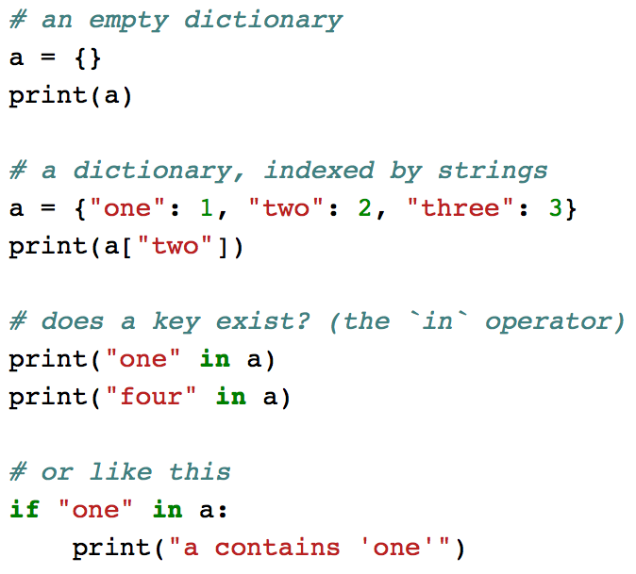
Dictionaries

Slide 53
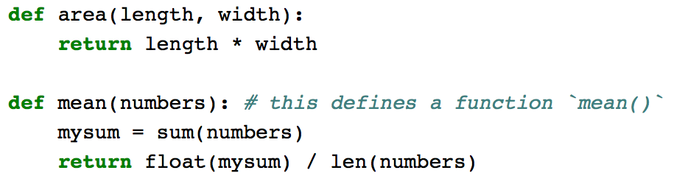
Functions
Functions are “predefined blocks of code” that accept parameters and return values
We have used quite a few functions already.

Slide 54
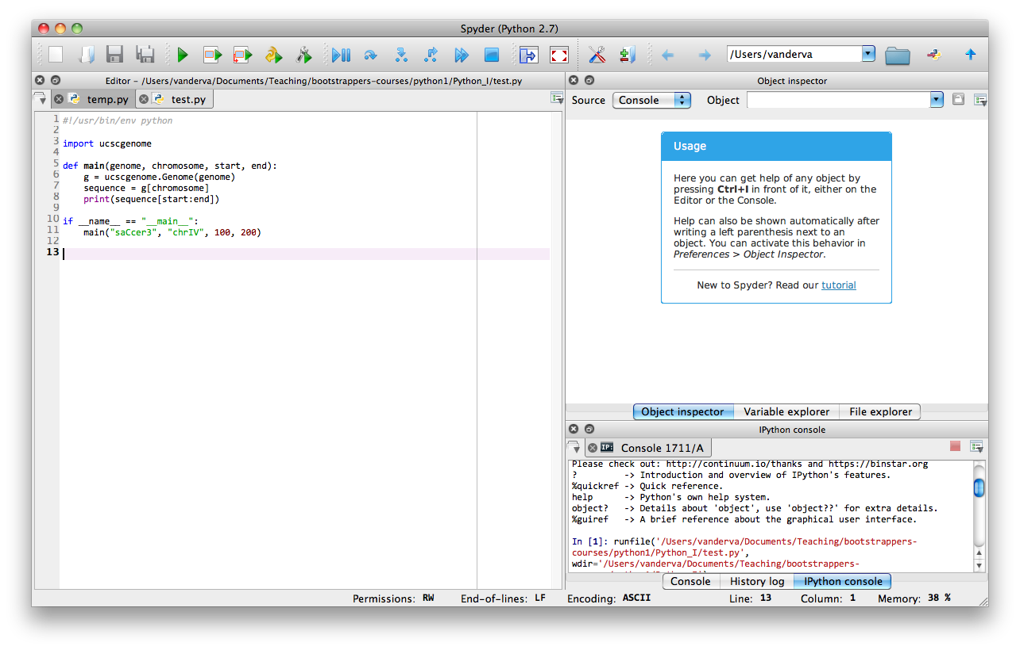
Spyder IDE

Slide 55
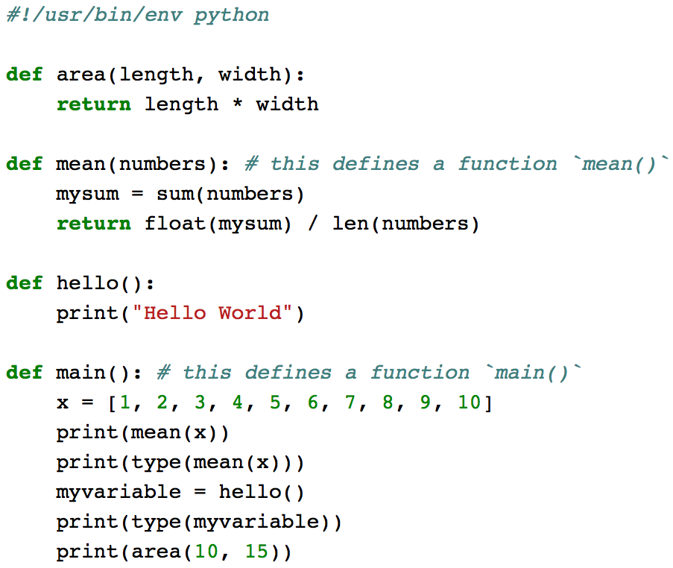

Scripting

Slide 56
Day 5

Slide 57
Python 2
6 sessions
Tuesday and Thursdays starting January 27, 2015
Will cover
More on functions
Classes
Debugging and testing
More advanced data structures
Reading/writing JSON and simple SQL databases
Matrices

Slide 58
Resources
Python cheat sheet
https://www.addedbytes.com/cheat-sheets/python-cheat-sheet/
pip repository
https://pypi.python.org/pypi/pip/
Scientific computing
http://pandas.pydata.org/
http://matplotlib.org/
http://www.scipy.org/
Online reading
http://inventwithpython.com/bookshelf/

Slide 59
IDE
Spyder
iPython notebooks
pyCharm
Eclipse

Slide 60
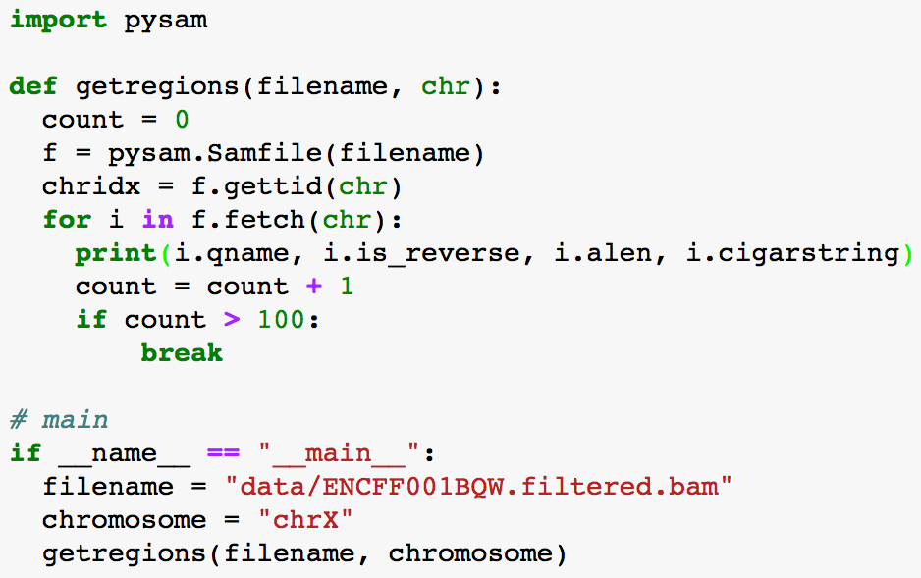
pysam

